Slide 1
SQL – PL/SQL Questions
ZERO TO HERO

Slide 2
QUESTIONS 1.1
Which of the following statements are true?
1. A column in a table defined as NOT NULL is a primary or foreign key.
2. Referential integrity is enforced by the relationship between the primary key and foreign key.
3. You can test for null values by using an empty string such as the following:
SELECT * FROM course WHERE prerequisite = ‘ ‘
4. Unlike many other character functions, the LENGTH and INSTR function return a NUMBER.

Slide 3
Question 1.2
Which of the following statements are true?
A DISTINCT must always be used in the top-most SELECT statement of a set operation.
It is possible to combine data from two tables that do not have a primary key/foreign key relationship into one result using a set operation.
You cannot order the results of a set operation.
To obtain a list of last names that students and instructors share, you use the MINUS set operator.
The UNION and UNION ALL set operators have the opposite effect of each other.
TeamNet - ZERO TO HERO

Slide 4
Question 1.3
Which of the following statements are true?
1. You cannot selectively delete rows from a table.
2. When inserting data into a table from another table, the table names and columns must be the same.
3. You can update only a single column at a time in a table.
4. The TRUNCATE command removes all data permanently from a table.
5. DML statements obtain a lock on the row(s), so other users cannot manipulate it.
6. A session is an individual connection to the Oracle database server.
7. Transaction control determines when data manipulation becomes permanent in a database.
8. DDL statements closed a transaction?
TeamNet - ZERO TO HERO

Slide 5
Question 1.4
Which of the following statements are true?
A table can be created with or without data.
A table cannot be dropped if it has data in it.
Constraints always have a name.
Constraints must be explicitly enabled before they can be used by the database.
You can add to and drop columns from a table using the ALTER TABLE command.
You can rename a table with the RENAME or the ALTER TABLE command.
A parent table referenced by a child table may not be dropped.
The data of a temporary table is visible to all sessions.
The NUMBER data type is usually the best choice for a primary key.
By default, the foreign key restricts deletes of any parent row that has a corresponding child row(s).
TeamNet - ZERO TO HERO

Slide 6
Question 1.5
Which of the following statements are true?
1. The following SQL query implicitly performs a data type conversion.
SELECT student_id, last_name
FROM student
WHERE student_id = '123‘;
2. What is the result of the following SQL query?
SELECT TO_NUMBER('ABC') FROM dual ;
TeamNet - ZERO TO HERO

Slide 7
Question 1.6
Which of the following statements are true?
1. Aggregate functions always return a single result for a group of values.
2. Aggregate functions usually ignore NULL values.
3. An aggregate function can be used in a HAVING clause.
4. The HAVING clause can be used instead of the WHERE clause.
5. The MIN and MAX functions work only on the NUMBER data type.
6. The following query is invalid?
SELECT SYSDATE, 'HELLO', student_id, COUNT(*)
FROM enrollment
GROUP BY student_id;
TeamNet - ZERO TO HERO

Slide 8
Question 1.7
Are the following two SQL statements equivalent?
SELECT s.student_id, e.section_id, s.last_name
FROM student s, enrollment e
WHERE s.student_id = e.student_id
AND last_name = 'Torres'
SELECT s.student_id, section_id, last_name
FROM student s JOIN enrollment e
ON (s.student_id = e.student_id)
WHERE last_name = 'Torres'
TeamNet - ZERO TO HERO

Slide 9
QUESTIONS 2
Given the following tables:
runners
| id | name |
| 1 | John Doe |
| 2 | Jane Doe |
| 3 | Alice Jones |
| 4 | Bobby Louis |
| 5 | Lisa Romero |
races
| id | event | winner_id |
| 1 | 100 meter dash | 2 |
| 2 | 500 meter dash | 3 |
| 3 | cross-country | 2 |
| 4 | triathalon | NULL |
What will be the result of the query below?
select * from runners where id not in (select winner_id from races)
TeamNet - ZERO TO HERO

Slide 10
Question 3
What will be the result of the query below? Explain your answer and provide a version that behaves correctly.
select case when null = null then 'Yup' else 'Nope' end as Result from dual;
TeamNet - ZERO TO HERO

Slide 11
Question 4
You own a table called EMPLOYEES with this table structure:
EMPLOYEE_ID NUMBER Primary Key
FIRST_NAME VARCHAR2(25)
LAST_NAME VARCHAR2(25)
HIRE_DATE DATE
What happens when you execute:
DELETE employees;
TRUNCATE table employees;
DROP table employees;
TeamNet - ZERO TO HERO

Slide 12
Question 5
What is the output of the following SELECT statement?
SELECT course_no, description
FROM course
WHERE course_no IN
(SELECT course_no
FROM section
WHERE location = 'L111')
OR prerequisite = 20
TeamNet - ZERO TO HERO

Slide 13
Question 6
What is the output of the following SELECT statement?
SELECT zip
FROM zipcode z
WHERE NOT EXISTS (SELECT null
FROM student
WHERE z.zip = zip)
AND NOT EXISTS (SELECT null
FROM instructor
WHERE z.zip = zip)
TeamNet - ZERO TO HERO

Slide 14
Question 7
King earns $5000 a month. What does the following query return?
SELECT CASE WHEN SAL>2000 THEN 1 WHEN SAL>4000 THEN 2 WHEN SAL>6000 THEN 3 ELSE 4 END "N" FROM EMP WHERE ENAME='KING'
TeamNet - ZERO TO HERO

Slide 15
Question 8
The following is the CREATE TABLE statement of a table named EMP and the CREATE VIEW statement of the MY_EMP view.
Determine the salary for the new employee Smith based on the INSERT statement issued.
CREATE TABLE emp
(emp_id NUMBER NOT NULL,
last_nm VARCHAR2(50),
salary NUMBER(10,2) DEFAULT 0 NOT NULL)
CREATE OR REPLACE VIEW my_emp AS
SELECT emp_id, last_nm
FROM emp
INSERT INTO my_emp
(emp_id, last_nm)
VALUES
(110, 'SMITH')
TeamNet - ZERO TO HERO

Slide 16
Question 9
What is the difference between these two statements?
IF total_sales <= 0 THEN
no_revenue := TRUE;
ELSE
no_revenue := FALSE;
END IF;
IF total_sales <= 0 THEN
no_revenue := TRUE;
ELSIF total_sales > 0 THEN
no_revenue := FALSE;
END IF;
TeamNet - ZERO TO HERO

Slide 17
Question 10
Which procedure will never be executed in this IF statement?
IF (order_date > SYSDATE) AND order_total >= min_order_total THEN
fill_order (order_id, 'HIGH PRIORITY');
ELSIF (order_date < SYSDATE) OR (order_date = SYSDATE) THEN
fill_order (order_id, 'LOW PRIORITY');
ELSIF order_date <= SYSDATE AND order_total < min_order_total THEN
queue_order_for_addtl_parts (order_id);
ELSIF order_total = 0 THEN
disp_message (' No items have been placed in this order!');
END IF;
TeamNet - ZERO TO HERO

Slide 18
Question 11
How many times does the following loop execute?
FOR year_index IN REVERSE 12 .. 1 LOOP calc_sales (year_index);
END LOOP:
TeamNet - ZERO TO HERO

Slide 19
Question 12
What message is displayed in the following block if the SELECT statement does not return a row?
PROCEDURE display_dname (emp_in IN INTEGER) IS
department# dept.deptno%TYPE := NULL;
BEGIN
SELECT deptno INTO department#
FROM emp
WHERE empno = emp_in;
IF department# IS NULL
THEN
DBMS_OUTPUT.PUT_LINE ('Dept is not found!');
ELSE
DBMS_OUTPUT.PUT_LINE ('Dept is ' || TO_CHAR (department#));
END IF;
EXCEPTION
WHEN NO_DATA_FOUND
THEN
DBMS_OUTPUT.PUT_LINE ('No data found');
END;
TeamNet - ZERO TO HERO

Slide 20
Question 13
What message is displayed in the following block if there are no employees in department 15?
PROCEDURE display_dept_count
IS
total_count INTEGER := 0;
BEGIN
SELECT COUNT(*) INTO total_count
FROM emp
WHERE deptno = 15;
IF total_count = 0
THEN
DBMS_OUTPUT.PUT_LINE ('No employees in department!');
ELSE
DBMS_OUTPUT.PUT_LINE
('Count of employees in dept 15 = ' || TO_CHAR (total_count));
END IF;
EXCEPTION
WHEN NO_DATA_FOUND
THEN
DBMS_OUTPUT.PUT_LINE ('No data found');
END;
TeamNet - ZERO TO HERO

Slide 21
Question 14
What message is displayed in the following block?
DECLARE
string_of_5_chars VARCHAR2(5);
BEGIN
BEGIN
string_of_5_chars := 'Steven';
EXCEPTION
WHEN VALUE_ERROR
THEN
DBMS_OUTPUT.PUT_LINE ('Inner block');
END;
EXCEPTION
WHEN VALUE_ERROR
THEN
DBMS_OUTPUT.PUT_LINE ('Outer block');
END;
TeamNet - ZERO TO HERO

Slide 22
Question 15
Rewrite the following loop so that you do not use a loop at all
FOR i IN 1 .. 2 LOOP
IF i = 1 THEN
give_bonus (president_id, 2000000);
ELSIF i = 2 THEN
give_bonus (ceo_id, 5000000);
END IF;
END LOOP;
TeamNet - ZERO TO HERO

Slide 23
Question 16
What statement would you remove from this block? Why?
DECLARE
CURSOR emp_cur IS
SELECT ename, deptno, empno
FROM emp
WHERE sal < 2500;
emp_rec emp_cur%ROWTYPE;
BEGIN
FOR emp_rec IN emp_cur LOOP
give_raise (emp_rec.empno, 10000);
END LOOP;
END;
TeamNet - ZERO TO HERO

Slide 24
Question 17
The following index was created on the STUDENT table:
CREATE INDEX stud_reg_dt ON student(registration_date)
Determine if the query takes advantage of the index.
SELECT student_id FROM student WHERE registration_date >= TRUNC(SYSDATE-1)
TeamNet - ZERO TO HERO

Slide 25
Question 18
The following index was created.
CREATE INDEX crse_cost_i ON course (cost)
Determine which of the following queries takes advantage of the index.
SELECT cost
FROM course
WHERE cost >= 11.2304
SELECT cost, course_no
FROM cost
WHERE cost <> 1200
SELECT cost, course_no
FROM cost
WHERE NVL(cost, 0) = 1200
SELECT cost, course_no
FROM cost
WHERE cost IS NULL
TeamNet - ZERO TO HERO

Slide 26
PL/SQL Optimization and Tuning
TeamNet - ZERO TO HERO

Slide 27
Candidates for Tuning
Code that spends much time processing SQL statements
Functions invoked in queries, which might run millions of times
Code that spends much time looping through query results
Etc..
TeamNet - ZERO TO HERO

Slide 28
Tune SQL Statements
Use appropriate indexes
- consider indexing keys (the column or expression on which you can build an index) that appear frequently in where clauses;
- consider indexing keys that frequently join tables in SQL statements;
- choose index keys that have high selectivity (the percentage of rows in a table having the same value for the indexed key)
- do not index columns that are frequently modified (update, delete)
- always index the foreign keys of referential integrity if a large number of DML statements access the parent and child tables
Analyze the execution plans and performance of the SQL statements
TeamNet - ZERO TO HERO

Slide 29
Hints
Use query hints to avoid unnecessary full-table scans
select /*+ INDEX (E EMP_DEPARTMENT_IX) */
e.*, d.department_name
from HR.EMPLOYEES e, HR.DEPARTMENTS d
where E.DEPARTMENT_ID=D.DEPARTMENT_ID;
TeamNet - ZERO TO HERO

Slide 30
Collect current statistics on all tables, using the subprograms in the DBMS_STATS package
Table statistics
Number of rows
Number of blocks
Average row length
Column statistics
Number of distinct values (NDV) in column
Number of nulls in column
Data distribution (histogram)
exec DBMS_STATS.GATHER_TABLE_STATS ('HR','EMPLOYEES');
TeamNet - ZERO TO HERO

Slide 31
Tune Function Invocations in Queries
Do not invoke a function in a query unnecessarily
Create a function-based index (ex. Upper(last_name)) because the query does not use an index on the column if the query passes a column to a function
To minimise the number of function invocations use a nested query (the inner query filter the result set to a small number of rows and the outer query invoke the function only for those rows)
FOR i IN ( SELECT DISTINCT(SQRT(department_id)) col_alias
FROM employees
ORDER BY col_alias )
LOOP
DBMS_OUTPUT.PUT_LINE('Square root of dept. ID = ' || i.col_alias);
END LOOP;
FOR i IN ( SELECT SQRT(department_id) col_alias
FROM (SELECT DISTINCT department_id FROM employees)
ORDER BY col_alias )
LOOP
IF item.col_alias IS NOT NULL
THEN DBMS_OUTPUT.PUT_LINE('Square root of dept. ID = ' || item.col_alias);
END IF;
END LOOP;
TeamNet - ZERO TO HERO

Slide 32
Bulk SQL and Bulk Binding
Use FORALL statement that sens DML statements from PL/SQL engine to SQL engine in batches, not one at a time, like FOR .. LOOP does
………………………………………………..
FOR i IN depts.FIRST..depts.LAST
LOOP
DELETE FROM employees_temp
WHERE department_id = depts(i);
END LOOP;
……………………………………………………..
………………………………………………………….
FORALL i IN depts.FIRST..depts.LAST
DELETE FROM employees_temp
WHERE department_id = depts(i);
……………………………………………………………
Implicit vs. Explicit Cursors
Implicit cursors are faster because the volume of the code being used is smaller than in case of explicit cursors
The code has to be as compact as possible
TeamNet - ZERO TO HERO

Slide 33
Partitioning
Allows tables or indexes to be subdivided into smaller pieces for a better performance and faster read
Each partition is independent (can drop a partition without affecting the others)
The tables, indexes are partitioned using a partitioning key, which is a set of columns that determine in which partition a given row will reside
TeamNet - ZERO TO HERO

Slide 34
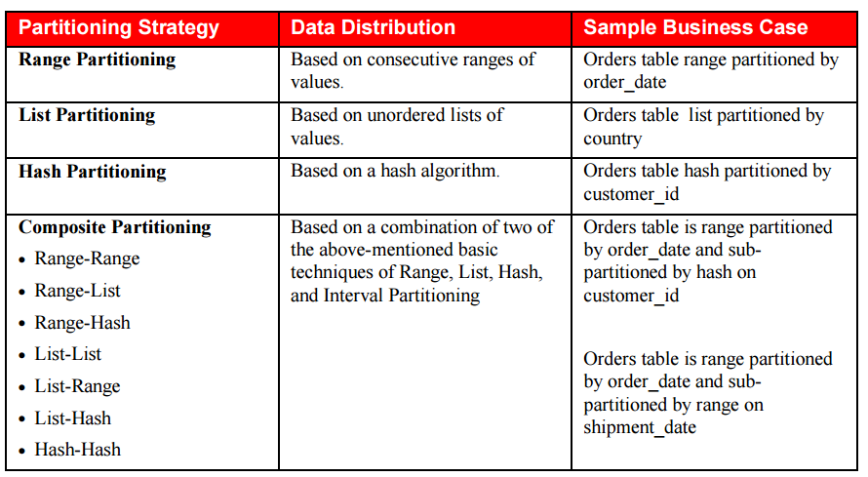
Partitioning Strategies
TeamNet - ZERO TO HERO

Slide 35
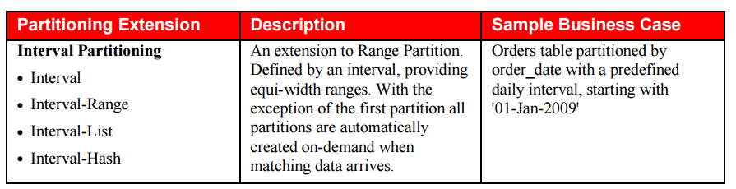
Partitioning Extensions
TeamNet - ZERO TO HERO

Slide 36
Range partition
Range partitioning maps data to partitions based on ranges of partition key values that you establish for each partition. It is the most common type of partitioning and is often used with dates
Each partition has a VALUES LESS THAN clause, which specifies a noninclusive upper bound for the partitions
A MAXVALUE literal can be defined for the highest partition. MAXVALUE represents a virtual infinite value that sorts higher than any other possible value for the partition key, including the null value
List partition
List partitioning enables you to explicitly control how rows map to partitions. You do this by specifying a list of discrete values for the partitioning key in the description for each partition
Unlike range and hash partitioning, multicolumn partition keys are not supported for list partitioning
The DEFAULT partition enables you to avoid specifying all possible values for a list-partitioned table by using a default partition, so that all rows that do not map to any other partition do not generate an error
Hash partition
Hash partitioning enables easy partitioning of data that does not lend itself to range or list partitioning. It does this with a simple syntax and is easy to implement
TeamNet - ZERO TO HERO

Slide 37
Local indexes
For every table partition, there will be an index partition that indexes just that table partition. All of the entries in a given index partition point to a single table partition, and all of the rows in a single table partition are represented in a single index partition.
Can support uniqueness if the partitioning key of the table is part of the index’s key columns
Global indexes
Partition the index by range or hash: Here the index is partitioned by range, or optionally in Oracle 10g and above by hash, and a single index partition may point to any (and all) table partitions.
These indexes can be maintained by appending the clause UPDATE GLOBAL INDEXES to the SQL statements for the operation
TeamNet - ZERO TO HERO

Slide 38
References
http://docs.oracle.com/cd/E11882_01/appdev.112/e25519/tuning.htm#LNPLS012
http://docs.oracle.com/cd/E11882_01/appdev.112/e25519/subprograms.htm#LNPLS702
http://www.dba-oracle.com/plsql/t_plsql_cursors.htm
http://www.oracle.com/us/sitemaps/twp-partitioning-11gr2-2010-10-189137.pdf
https://docs.oracle.com/html/A96524_01/c12parti.htm#459652
TeamNet - ZERO TO HERO

Slide 39
THANK YOU!

